Slide 1
Probability of cancellation
By 119ec0039

Slide 2
ProblemStatement
Find the Probability of booking cancellation of a ceratin hotel based on its dataset of booking history using presice regression model

Slide 3
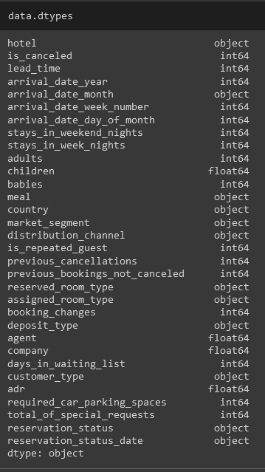
Dataset dtypes
After loading the dataset the data types of each and every column is found by using “df.dtypes”command” . Which will be helpfull while filling missing values

Slide 4
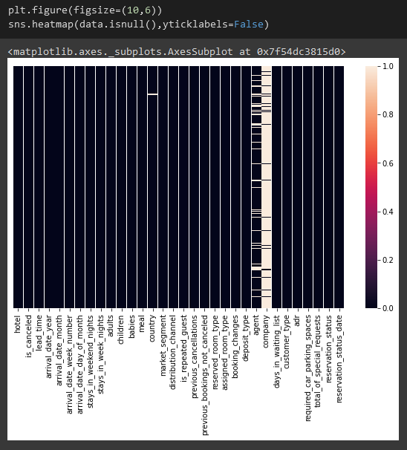
Heatplot the missing places

Slide 5

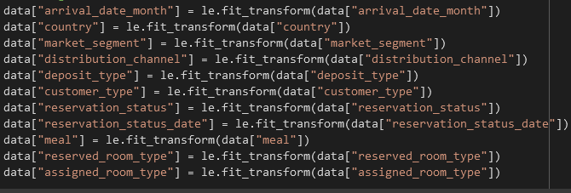
Encoding & .fillna()

Slide 6
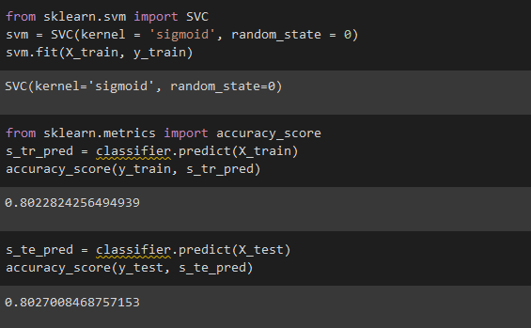
SVM for the dataset

Slide 7
Conclusion
Hence I consider the svm method for finding the probability as it a got high score compare to other methods.

